Slide 1
Software Requirements Specification for Attendance Management Software
Page 1
Experiment-1 ( Requirement Specification)
Aim: To learn & implement SRS.
Objective: To implement Software Requirement Specification (SRS) and design the documentation for given project.
Background: A software requirement specification (SRS) is a comprehensive description of the intended purpose and environment for software under development. The SRS fully describes what the software will do and how it will be expected to perform.
Prerequisite: The general format of SRS consists of:
Functional Requirements Definition
Functional requirements are a subset of the
overall system requirement.
These requirements are used to consider system
behavior.
Trade-offs may be between hardware and
software issues.
Non-functional Requirements Definition
It measures the documentation and the inputs
for the various requirements in the system.
System Evolution
Starting from the specification and the database
schema, on how the system should be designed.

Slide 2
Software Requirements Specification for Attendance Management Software
Page 2
Software Requirements
Specification
for
Attendance Management Software
Version 1.0
Prepared by
Madhuresh
Tejas
Lakshmanan
Jagan
Jushwa
2/12/2022

Slide 3
Software Requirements Specification for Attendance Management Software
Page 3
Table of Contents
Table of Contents
Introduction
Purpose
Product Scope
References
Overall Description
Product Perspective
Product Functions
User Classes and Characteristics
Operating Environment
Design and Implementation Constraints
User Documentation
Assumptions and Dependencies
External Interface Requirements
User Interfaces
Hardware Interfaces
Software Interfaces
Communications Interfaces
Functional Requirements
Nonfunctional Requirements
Use-case Diagram
Conclusion

Slide 4
Software Requirements Specification for Attendance Management Software
Page 4
Introduction
Purpose
The Aim of this Web App is to provide an easy and intuitive way to track attendance of students.This makes it easier for the attendance coordinator to manage attendance of different departments and respective students. It allows students to view their attendance and also enables attendance department to generate different attendance reports.
Features includes:
Online Attendance Tracking
Employee Reporting
Calculate Defaulter Categories.
Class and Student Management.
1.2 Product Scope
The scope of this project is developing a attendance tracking product system which can be used in by lecturers to manage their class’s attendance. It targets large organizations which include many classes and Students. It also targets normal lecturers for keeping track for attendance and thus taking and managing attendance online.
References
Website: url [ http://www.cse.msu.edu/~cse870/IEEEXplore-SRS-template.pdf ]
Website: url [https://www.scribd.com/doc/56207840/Student-Attendance-Management- System-PF ]
Website: url [ - www.wikipedia.com ]
“Roger Pressman”,”Software Engineering”,Seventh Edition, Page: 119-153
Overall Description
Product Perspective
The Tracking software can be accessed Online in which the organisation intends to track.The site allows to take and store attendance online and store it in database.It enables users to generate various reports on attendance. The Attendance Management System is intended to replace the manual model of attendance record

Slide 5
Software Requirements Specification for Attendance Management Software
Page 5
keeping by means of roll call and paper records. The roll call and paper records are replaced with a single interaction between the professor and the Attendance Management System. Professors will be able to view details regarding attendance of individual students on their PC and quickly maintain attendance records. The features expressed in this Software Requirements Specification document are intended to be fully implemented in version 1.0. Then system will be developed in such a way to provide easy addition of enhanced features, which may be desired in subsequent versions.
Product Functions
The main feature of the Attendance Managemant System is that it keeps a record of all essentials details of each individual student.At the end of a specified period this system create a defaulties list as well as the non- defaulties list. Attendance Percentage of each student in every subject would be displayed in this list Also, the system allows the professor to view pertinent statistics on student’s attendance record for the specified class. Finally, another feature of Attendance Management System is its flexibility and ease of use.
User Classes and Characteristics
Administrator:
The administrator will have overall control over the system.The admin maintains the site and service. It has privilege to access the entire system and distribute the permissions to group of users.
Lecturer:
Lecturer is responsible in taking attendance. It maintains classes, keeps a track of the students. It also assists the other departments like attendance and HR department.
Student:
They are allowed to only view their attendance details for knowledge.

Slide 6
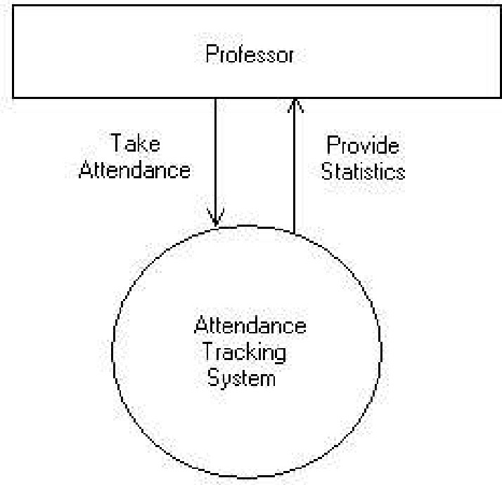
Software Requirements Specification for Attendance Management Software
Page 6
Figure 1: Context diagram for Attendance Management System.
Operating Environment
The Attendance Management System shall function on the PC provided by the college. This entails the system to operate on the Windows CE platform.
The Attendance Management System shall interface between Windows CE designated to
store the attendance records. The Web Server and Database Software have not been established at this point.
The Attendance Management System will record all the essentials details of each particular
student.
Pentium 3.0 GHz or higher RAM must be 1 Gb or more and Hard Drive 10 GB or more.
Design and Implementation Constraints
The time allotted for this project will be limited to the end of this semester.
The language for the project will be PHP at the server side..
All the HTML code for the user manual will conform to the HTML 4.0 standard.
Programming is done in JAVASCRIPT, SQL, HTML.
User Documentation
The system will provide an online user manual in HTML that describes the functionality and options available to the user.

Slide 7
Software Requirements Specification for Attendance Management Software
Page 7
The system will provide a hard copy of the user manual, which is identical to the manual outlined above
Assumptions and Dependencies
The database mentioned within this Software Requirements Specification document is previously administered with the correct information needed by the Attendance Management System.
For attendance policies, since professors do not usually tabulate tardiness, it is assumed a
student is either present or absent. The system also assumes that detail regarding each student would be made correctly.
Class data being used for setup and student recognition is dependent on information in a
database administered outside of the capabilities of the Attendance Management System.
Statistics on student attendance is dependent on a professor’ s consistent utilization of the
system for each class period.
External Interface Requirements
User Interfaces
The Attendance Management System shall provide details of students in the class to aid in taking roll.
These details can be clicked with a mouse in order to view a particular student’s attendance
record.
All modifications to the database will be done through a keyboard.
Application will be accessed through a Browser Interface. The interface would be viewed
best using 1024 x768 and 800 x 600 pixels resolution setting.
The program will provide a page that produces current statistics on class attendance
Hardware Interfaces
Server Side:
Operating System: Windows 7/xp ,Windows ME
Processor: Pentium 3.0 GHz or higher
RAM: 1 GB or more
Hard Drive: 10 GB or more
Client side:
Operating System: Windows 7 or above, MAC or UNIX.
Processor: Pentium III or 2.0 GHz or higher.
RAM: 1 GB or more

Slide 8
Software Requirements Specification for Attendance Management Software
3.3 Software Interfaces
Page 8
Attendance Management System
This software will transmit the attendance of a class to a database on a machine via Internet.
The user will be allowed to modify attendance records at any time.
If the user forgets to transmit the information, the system will automatically send it for them
at the end of the class.
Database
The Attendance Management System will communicate with the database to perform the following options.
To allow a user to enter attendance.
To allow a user to modify attendance.
To allow a user to query a system to gain statistics concerning individual and class
attendance.
Communications Interfaces
The security of a user must be consistent through the use of passwords.
The Attendance Management System will communicate to the database through Internet.
4 Functional Requirements:
Registered Lecturers:
He or she can add classes.
He/she can add students to that class.
Lecturer can take attendance online.
He/she can view the attendance according to the date.
Provide Registration Form:
Allows users to fill the sign-up forms and get registered
It allows customers to rate the products and services.
Suggestions & online survey:
This section helps the organization to fulfil the new customer's demands
about the products, service, user-interface, etc.
And hence enhance the product functionality and improves services.
Take online attendance:
It allows to take attendance roll number wise and store them in database.
Report generation:
Monthly reports
Student wise reports
Defaulter List
Manage the attendance of students for special lectures.

Slide 9
Software Requirements Specification for Attendance Management Software
Page 9
Non - Functional Requirements
Security:
Security is concerned with the privacy of client’s personal information.The attendance made by the clients are dealt confidentially.The complaints and suggestions made by customers must be only accessed by administrative authorities.
Maintainability:
The maintainability requirements are concerned with the maintenance issues of the system.The report time of Attendance Tracking System shall be under a half hour.System downtime for maintenance should be less than 6 hours per quarter of a year.
Browser Compatibility and Responsive:
It ensures that the site runs consistently in all browsers without making change in Style of web page.Responsiveness ensures it works on every screen resolutions like mobile , tablets, desktop PCs.
Performance Requirements
The program must be able to be run concurrently by multiple professors. During peak times of usage (9:00 AM to 2:00 PM).
Transmission of roll data shall occur in under 5 seconds.
Acknowledgement of roll received (confirmation) shall be returned within 8
seconds.
Queries upon the database shall be performed in less than 5 seconds.
Upon start of the roll program, roll information shall be displayed on the
instructor’ s Pocket PC within 10 seconds.
Email messages to absent students shall be sent within one hour of the
conclusion of a class.
The program shall support taking roll for class sizes of up to 100 students.
With a maximum class size, performance must still conform to all performance requirements.
Safety Requirements
System would be protected by a password.
As it is connected via LAN and MAN an antivirus has been installed on
system for its safety purpose

Slide 10
Software Requirements Specification for Attendance Management Software
Security Requirements
Page 10
An instructor shall permitted to view and edit absence information in the database for only his/her classes.
In order to take roll or edit database information, the instructor shall be
required to enter a password. This password shall be stored on the instructor’ s PC after initial entry in order that it must only be entered once.
Passwords shall be stored in an instructor database and verified upon each
session of roll or database modification.
An instructor shall be allowed to change his/her password only by
supplying his/her existing password. The updated password shall be stored in the instructor database and on the instructor’s PC.
Software Quality Attributes
The system shall be available to all instructors through Information Systems during their normal hours of operation.
Due to the use of a wireless network, reliability of the system at all times is
not guaranteed. However, overall reliability of the system and roll information shall be achieved through the process of database manipulation.
The system shall be able to be reused for each new semester.
If no network connection can be established to receive the roll information,
the instructor shall be allowed to e
nter roll later.
If a network connection is lost during roll, the program shall allow the
instructor to transmit roll information at a later time.
The system shall allow for addition or deletion of instructors, students, and
classes while incorporating new semesters.
Usability of the system shall be achieved through an online help pages and
an introductory training session for all instructors upon installation of the program on their Pocket PCs.
7. Use-Case Diagram :

Slide 11
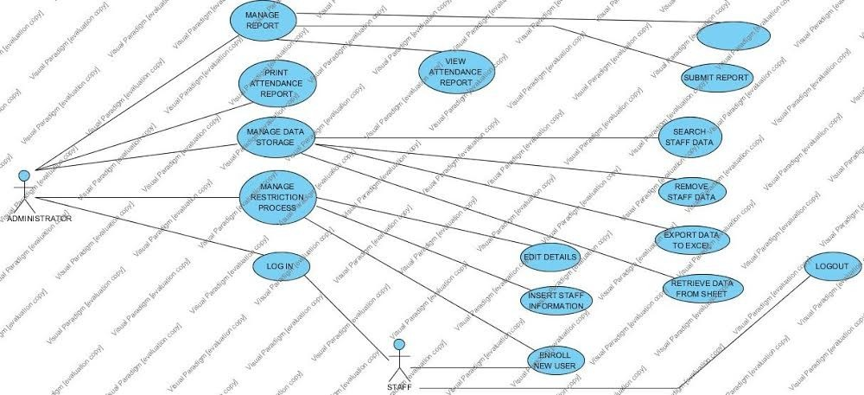
Software Requirements Specification for Attendance Management Software
Page 11
The purpose of use case diagram is to capture the dynamic aspect of a system. But this definition is too generic to describe the purpose.Use case diagrams are used to gather the requirements of a system including internal and external influences. These requirements are mostly design requirements. So when a system is analyzed to gather its functionalities use cases are prepared and actors are identified.
Actors:
Staff
Administrator
System
Use-case:
Login
Manage registration process
Enroll new user
manage data storage
print attendance report
logout
view attendance report
submit report
edit details
export data to excel

Slide 12
Software Requirements Specification for Attendance Management Software
Conclusion:
The requirements of all the entities are taken care of to be fulfilled. The system proves to be a helpful source for the Colleges to manage attendance easily and without involving much complex calculation. The management becomes comparatively easy and also efficient giving more time to the users to focus on other important issues.
Page 12

